Slide 1

Error Handling
Clean Code – Chapter 7

Slide 2
Introduction
Things can go wrong (input can be abnormal, devices can fail), when this happens, we are responsible for making sure that our code does what it needs to do.
Error handling is important, but if it obscures logic, it’s wrong.

Slide 3
Use Exceptions Rather Than Return Codes
Problems with error codes:
clutter the caller.
easy to forget to check for errors.
Mix error handling with the main algorithm logic.
The exception-based is cleaner because:
error handling is separated from the main algorithm.
the core logic is more readable.
error checking happens in a dedicated try-catch block.
each concern can be understood independently.

Slide 4
Write Your Try-Catch-Finally Statement First
try blocks are like transactions. Your catch has to leave your program in a consistent state, no matter what happens in the try.
So, it’s a good practice to start with the code that could throw exceptions.
Try to write tests that force exceptions and then add behavior to your handler to satisfy your tests.
This will cause you to build the transaction scope of the try block first and will help maintain the transaction nature of that scope.

Slide 5
Use Unchecked Exceptions
Many successful languages (C#, C++, Python, Ruby) can write robust software even they don’t have checked exceptions.
Checked exceptions violate the Open/Closed Principle.
They break encapsulation because every function in the exception’s path must know about low-level implementation details.
While checked exceptions might be useful for critical libraries, in general application development, their dependency costs outweigh their benefits.

Slide 6
Provide Context with Exceptions
Each exception that you throw should provide enough context to determine the source and location of an error.
Create informative error messages and pass them along with your exceptions.
Mention the operation thar failed and the type of failure.

Slide 7
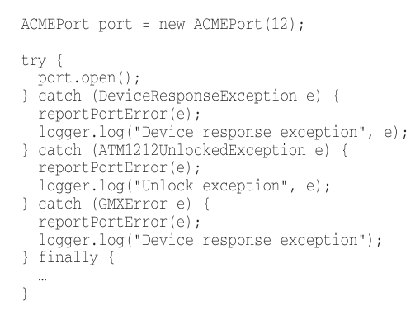
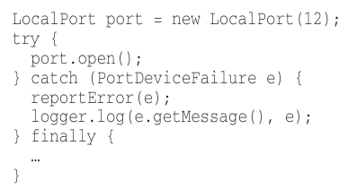
Define Exception Classes in Terms of a Caller’s Needs
We can classify errors by their (source/type), but the most important concern should be how they are caught.

Slide 8
Define Exception Classes in Terms of a Caller’s Needs (cont.)
Instead of handling multiple specific exceptions, create a wrapper class that:
encapsulates the third-party API.
catches all the various exceptions internally.
translates them into a single, common exception type.
allows the calling code to handle just one exception type.

Slide 9
Define Exception Classes in Terms of a Caller’s Needs (cont.)
Benefits of wrapping a third-party APIs:
Reduces dependencies: makes it easier to switch to different libraries later.
Improves testability: easier to mock third-party calls during testing.
Design freedom: you can define APIs that feel comfortable rather than being tied to vendor choices.
Cleaner code: single exception handling instead of multiple duplicate catch blocks.

Slide 10
Define the Normal Flow
Following good separation between business logic and error handling can sometimes lead to awkward code where exceptions clutter the main logic flow.
Use the Special Case Pattern when you have predictable “exceptional” scenarios that are actually part of normal business flow. Instead of forcing clients to handle theses cases with exceptions, encapsulate the special behavior in objects that conform to the expected interface.

Slide 11
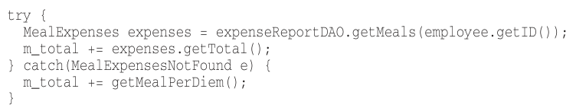

Define the Normal Flow (cont.)

Slide 12
Don’t Return Null
The problem with returning null:
Creates excessive null checks throughout the codebase.
Forces callers to handle null cases, creating additional work and complexity.
Missing just one check can cause NullPointerException and crash the application.
Results in deeply nested, hard-to-read code.

Slide 13
Don’t Return Null (cont.)
Better alternatives to returning null:
Throw an exception: that describes the problem.
Return a Special Case object.
Wrap third-party APIs.
Benefits:
Cleaner code: eliminates defensive null checking.
Fewer bugs: reduces NullPointerException risks.
Better readability.
Easier maintenance.

Slide 14
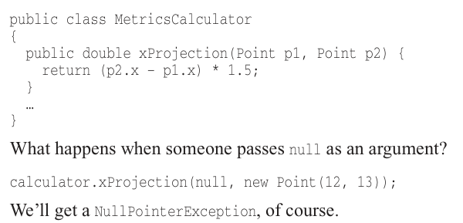
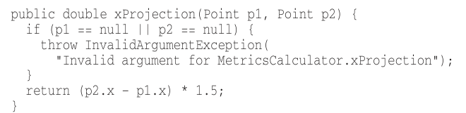
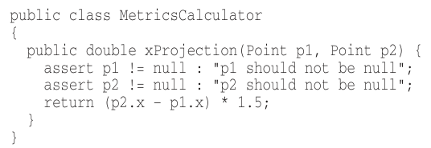
Don’t Pass Null
Passing null into methods is worse than returning null from.

Slide 15
Don’t Pass Null (cont.)
Previous solutions don’t solve the problem.
In most programming languages there is no good way to deal with a null that is passed by a caller accidentally.
So, the rational approach is to forbid passing null by default.
When you do, you can code with the knowledge that a null in an argument list tis an indication of a problem, and end with far fewer careless mistake.

